Slide 1
SECUTIRY BONDS AND GUARANTEES FOR A ROAD CONTRACTOR
Module Five : Session five

Slide 2
Training objective:
Security bonds and guarantees in road construction business.

Slide 3
Training outcome:
By the end of the session trainees should be able to:
Appreciate, acquire and use security bonds
Seek insurance cover and guarantees for business operations in road construction.

Slide 4
Bid Bond or Bid Security
Required when a contractor is bidding for a job.
Guarantees that Contractor will not pull out of the bid if contract is awarded.
Contractor must secure bonds with banks or sign a counter guarantee for the insurance company who execute the Bond.
Bond Value is usually 1% or 2% of the bid amount.
Bid bond is valid for either 90 or 120 days.

Slide 5
Performance Bond
Required after contract award confirming that the Contractor will perform to the terms and conditions of the contract.
Bond value is usually 10% of contract value.
Contractor must secure the value with a bank or sign a counter guarantee before the Bond is executed by an Insurance Company.
A bond fee or premium must also be paid in advance.
The premium rate depends on the contactor but minimum is 2.5% of the Bond value.

Slide 6
Advance Payment Bond
Required when Contractor obtains an advance payment for mobilization.
Guarantee that the money advanced will be used for mobilization.
Security for a bank or a counter guarantee for an insurance Company is required to execute the Bond.
A bond fee or premium must be paid in advance.
Premium rate is around 3% of the amount advanced.

Slide 7
Retention Bond
Required before contractor is fully paid.
Retention money is held until expiry of the maintenance period.
If a contractor produces this bond the Employer releases the retention money.
Contractor, as for other Bonds, must produce a counter guarantee.

Slide 8
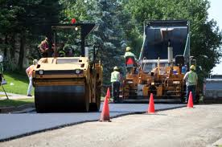
Contractors’ All Risks
In joint names of the Employer and the Contractor.
Insures contract works until completion of the contract.
Includes public liability for death or bodily injury and damage to third party property.
Maintenance period ranges from 6 to 12 months depending on contract terms.

Slide 9
Contractors Plant and Machinery
Covers any unforeseen and sudden damage from any cause to the property insured.
Cover applies whether or not the insured property is functioning or at rest or being dismantled.
Includes re-erection after successful commissioning.
Sum insured is new or replacement with similar plant or machinery.
Normal exclusions apply.
Cover runs for twelve months.

Slide 10
Role Of an Insurance Broker
Arrange and service insurances on the insured’s behalf.
Paid by an Insurance company by way of commission on chargeable premium.
Loyalty is to the client despite being remunerated by the Insurance Company.
Premiums are the same whether or not the Inured goes direct to the Insurance Company.

Slide 11
Claims Management
Notion that Insurance Companies are thieves is false.
Insurance is a contract and Insured must play their part by submitting all necessary documents in support of a claim in time.
Prompt claim settlement is the “Shop Window” of an Insurance Company.
There is a Complaints Bureau at The Insurance Regulatory Authority where any aggrieve party can report any complaint regarding claims or any other insurance matter.

Slide 12
Workers Compensation Insurance
Workers Act 2000 mandates all Employers to insure their employees against accidents while on duty.
Cover is for 12 months.
Premium is based on employees earnings.
Duty is to and fro.

Slide 13
Motor Comprehensive Insurance
Accidental damage, fire and theft to motor vehicles
Breakage of wind screen
Third party body injury
Third party property damage
The value of the vehicle is the sum insured.

Slide 14
Erection all risks
Insures erection risks e.g. negligence or lack of skill
Commences on unloading until testing operations have been completed.
Cover includes loss or damage during storage, erection and test operations.
Insured can be the supplier if there are erecting the machinery, the purchaser or the contractor commissioned to carry out the erection.

Slide 15
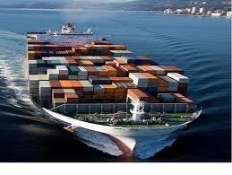
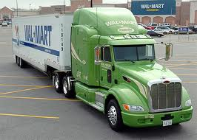
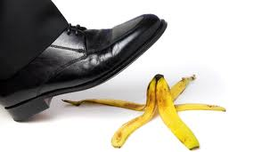
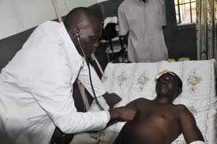
Other insurances
Fire and Special Perils
Burglary/Theft
Public Liability
Money
Plate Glass
Marine Cargo
Goods in Transit
Travel and Baggage
Business Interruption
Fidelity Guarantee
Domestic Package
Machinery Breakdown
Professional Indemnity

Slide 16
Group Activity
Describe the ethical issues in use of security bonds and guarantees
Using personal experience discuss the benefits of security bonds in construction business and estimate possible annual cost
Describe the limitations of security bonds and guarantees.
From the master case study imagine you were Munaku what mechanism would you have put in place to mitigate loss caused by the damage to the equipment.
Identify the key challenges faced in acquisition of security bonds in the construction industry and suggest how they can be addressed.

